Slide 1
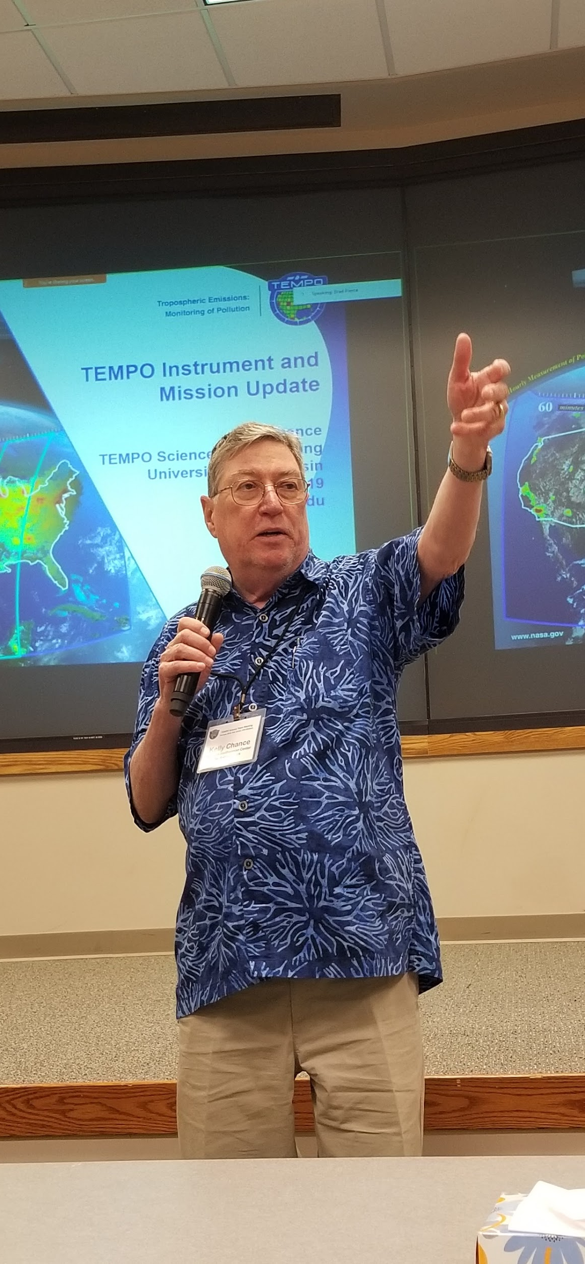
TEMPO/GeoXO JOINT PANEL
Significant Points from the Panel:
GEO/LEO intercalibration and assimilation are essential
A UV-VIS Component of the Global Space-Based Inter-Calibration System (GSICS) needs to be developed
Validation is not adequately addressed
What is the funding plan for analyses?
The path forward for GEO-XO encompasses a broad spectrum of users and is off to a good start, but will benefit from early TEMPO results and lessons.
GEMS observations provide an excellent set of guideposts
TEMPO commissioning comprises a large number of complex operations – SAO and NASA know what to do with a lot of support from Ball, Maxar, and Intelsat
TEMPO survived a large number of intense reviews, launched to orbit, and is currently in the complex commissioning phase (please don’t get in the way)
GeoXO ACX will bring TEMPO AQ-observation capability to a higher level and broader constituency: Start with the CEOS (GEMS/TEMPO/S4) constellation.
TEMPO’s international partners are counting on using its observations for a wide variety of AQ issues
If we need to continue the mission, we can build a TEMPO2 in short order
Successful application of TEMPO observations requires detailed understanding of atmospheric chemical processes: temporal, spatial, emissions, meteorology
We need to measure the IR gases
Who will observe over S. America, Africa, and India?

Slide 2
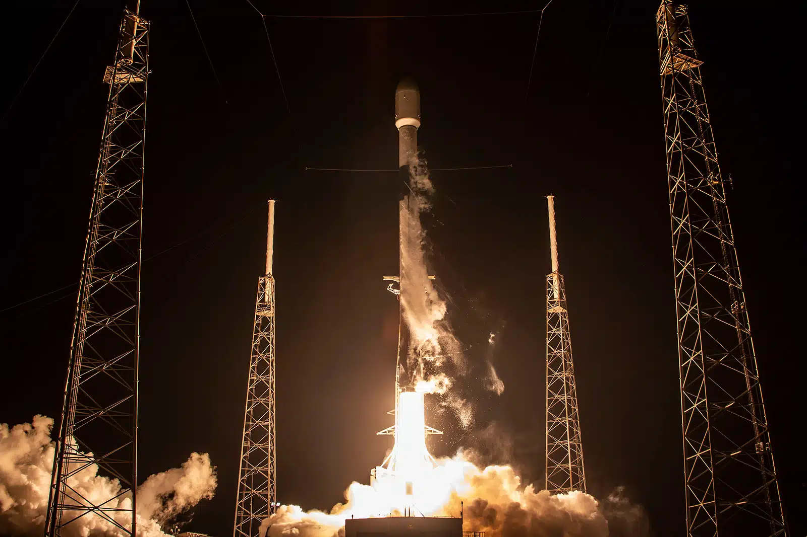

Session III: TEMPO/GeoXO Joint Panel
David Edwards, NCAR
Image credit: Intelsat

Slide 3
Discussion Questions
Discuss in broad terms how we envision the pathway from TEMPO to GEO-XO
How will our experience with geostationary measurements of gases and aerosols influence our planning for GeoXO ACX?
How best can we ensure the continuity of measurements and products from TEMPO to GeoXO ACX?
What new science and applications can be achieved through geostationary air quality measurements through the 2040s?
What new or enhanced partnerships should be engaged from TEMPO to GeoXO ACX?
How best can we shift from early adopters to pathfinders?
How can TEMPO-CI help fill any gap period between TEMPO and GeoXO?
Status and specifications of TEMPO-CI?

Slide 4
Discussion Questions 1
How will our experience with geostationary measurements of gases and aerosols influence our planning for GeoXO ACX and/or TEMPO-CI?
Although ACX is based on TEMPO, it would be good to leave design flexibility to allow for modifications based on lessons from GEMS, TEMPO data use. These are still early days, GEMS data are not yet widely used and we are awaiting TEMPO. We are going to learn a lot that’s new.
The GEO-CAPE/TEMPO STM and measurement requirements should be revisited in light of changing science questions/requirements and instrumentation capability. Review the role of GEO observations within the current integrated observing/modeling/machine learning framework. What has changed?
Refine requirements with new OSSE studies leveraging GEMS/TEMPO/S-4 experience.
Develop comprehensive validation plans, ground-based correlative measurement networks and field campaign ideas. This infrastructure can be for validation and also part of the integrated observation suit.

Slide 5
Discussion Questions 2
How best can we ensure the continuity of measurements and products from TEMPO to GeoXO ACX?
Adequate team funding for algorithm maintenance/development, data product dissemination and user entrainment, science team activities, training of next-generation scientists. Lessons learned from successful teams that have developed follow-on instruments, e.g., OMI/TROPOMI.
There is likely to be a need for significant algorithm development as we better understand the measurements and the underlying dependencies on diurnally changing parameters that all have to be accounted for in the radiative transfer, retrievals etc.
What new or enhanced partnerships should be engaged from TEMPO to GeoXO ACX?
Continue to think in terms of satellite constellation frameworks. The work under CEOS has been very important advocacy for GEMS/TEMPO/S-4.
Data will hopefully find new user communities now that observations and models have reached to same scales.

Slide 6
Discussion Questions 3
What new science and applications can be achieved through geostationary air quality measurements through the 2040s?
Time-resolved measurements are the unique contribution of the GEOs. Basic research is still required to understand the diurnal processes - emissions, chemistry, transport, meteorology - that determine composition.
Modeling/DA/data management challenges have to be addressed to fully exploit the GEO observations for research and applications and encourage uptake of the data.
SWIR channel (CO2, CH4, CO) for carbon studies is capability that is currently missing. GEO offers measurement advantages with dense data to extract weak signals.
What techniques can be developed to relate column measurements to surface concentrations for deriving emissions and exposure? Multispectral retrievals for profile info, machine learning…
What are the synergies with other platform data? ACX UV-vis + GXS IR measurements? S-4/IRS should show the value of a wider suite of gases.
The Southern Hemisphere: We’re missing half the globe with the current constellation, it’s the half we know least about and where changes due to development and climate will have consequences for atmospheric composition. Separate southern-looking GEOs for Africa and S. America? Scanning GEOs?

Slide 7
TEMPO / GeoXO Joint Panel: Paving the Future of Geostationary Air Quality Observations
Gregory Frost
NOAA Office of Oceanic and Atmospheric Research

Slide 8
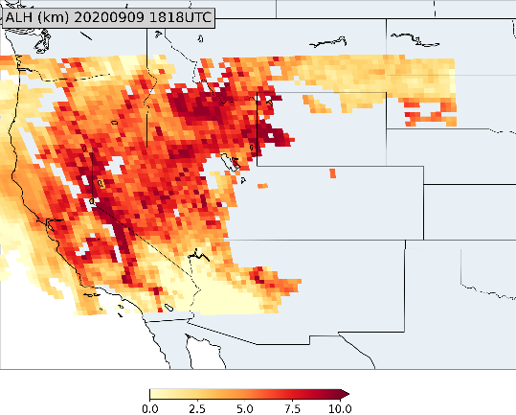
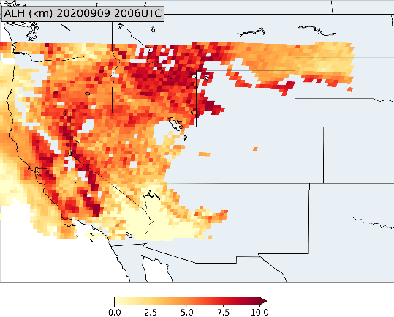
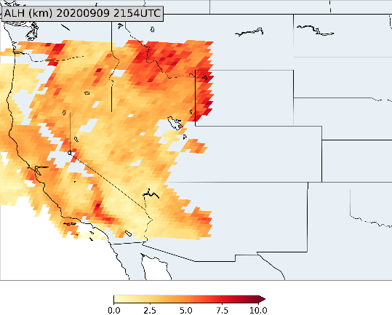
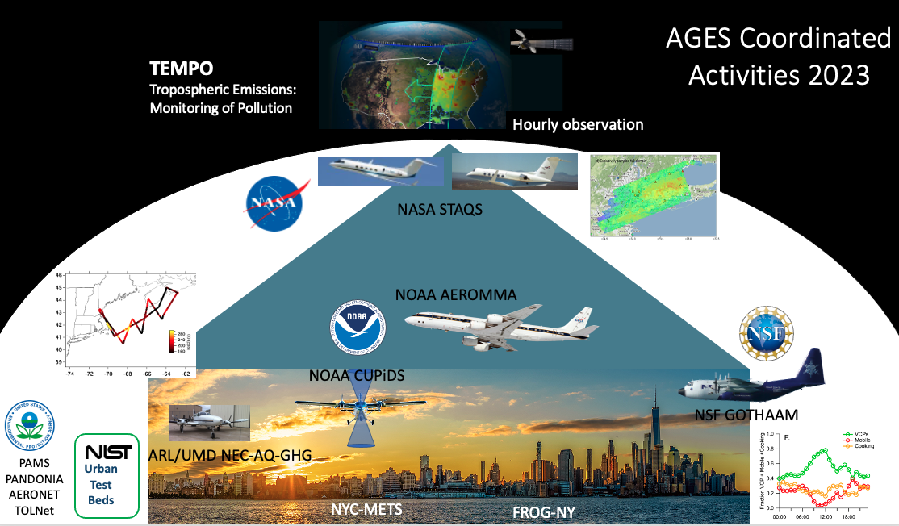

How will our experience with geostationary measurements of gases and aerosols influence our planning for GeoXO ACX?
Product development
Trace gases
Aerosols
Blended products
1818 UTC
2006 UTC
2154 UTC
Evaluation proving grounds
Field campaigns
Long-term monitoring
AGES+ Coordinated Activities 2023
https://csl.noaa.gov/projects/ages/
AGES+ =
AEROMMA+CUPiDS
GOTHAAM
EPCAPE
STAQS
+ …

Slide 9
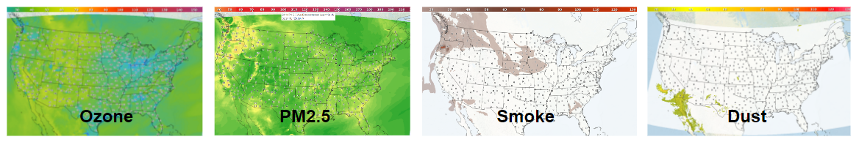
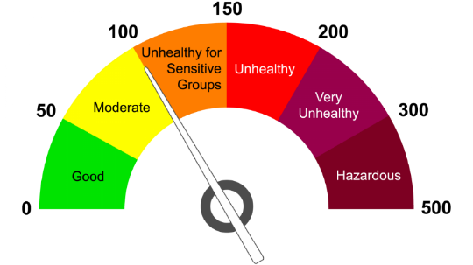
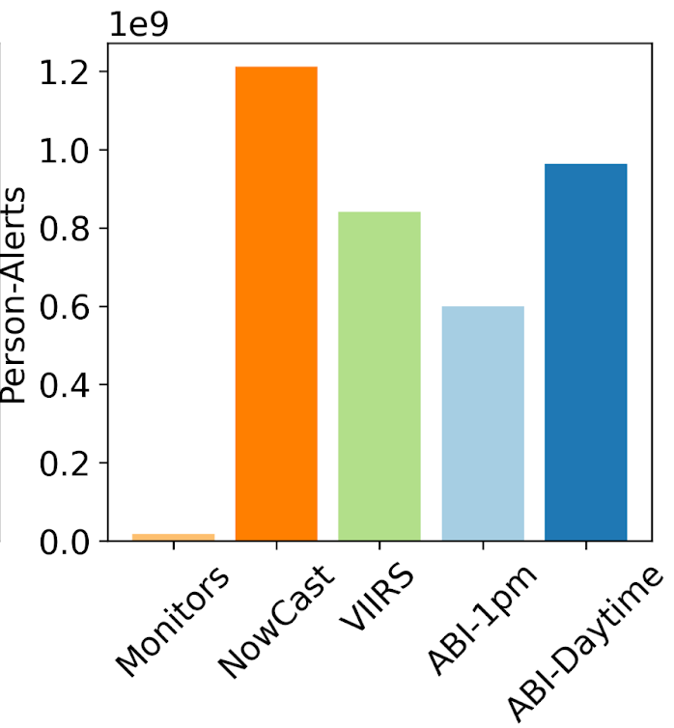
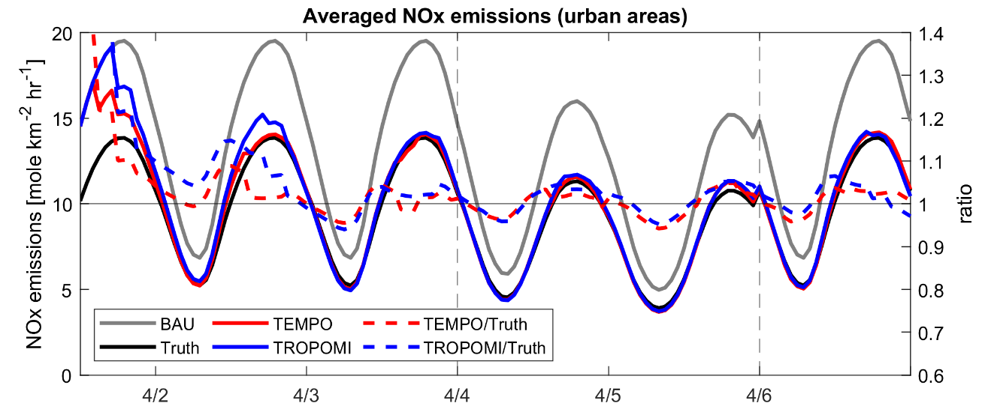
What new science and applications can be achieved through geostationary air quality measurements through the 2040s?
NOAA National Air Quality Forecasting Capability
Near-real-time emissions
Chemical data assimilation
Air quality forecasting
Pollution exposure studies
Environmental justice research
NOx Emissions in April 2020
True = COVID-19 period, BAU = Business-as-usual,
TEMPO = BAU adjusted using TEMPO proxy data
GeoXO Value Study: The Value of GeoXO Atmospheric Composition Observations for Emissions Updating and Air Quality Forecasting
PI: Brian McDonald, Co-Is: Chia-Hua Hsu, Arthur Mizzi, Daven Henze
GeoXO Value Study: Value of GeoXO Atmospheric Composition Data for Estimating Air Pollution-Related Health Impacts
PI: Susan Anenberg, Co-Is: Katelyn O’Dell, Gaige Kerr, Dan Goldberg

Slide 10
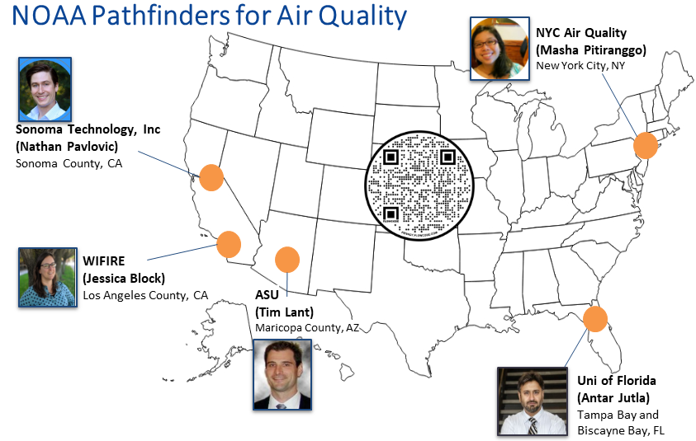























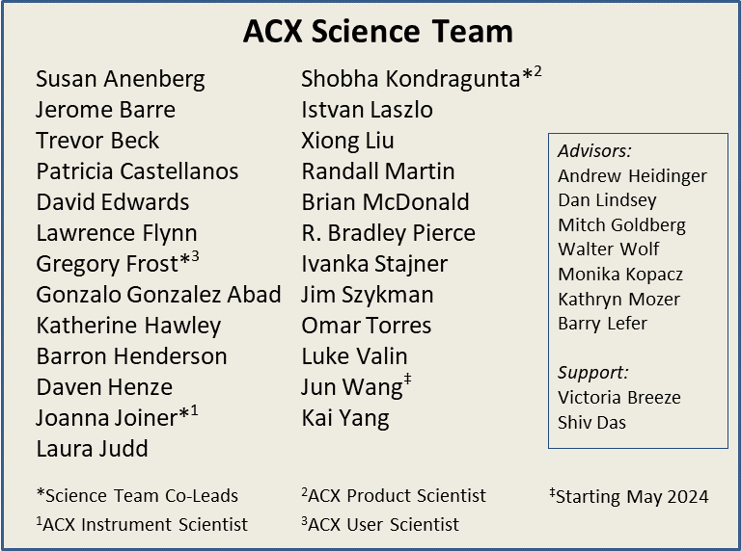
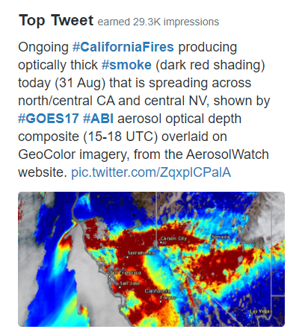
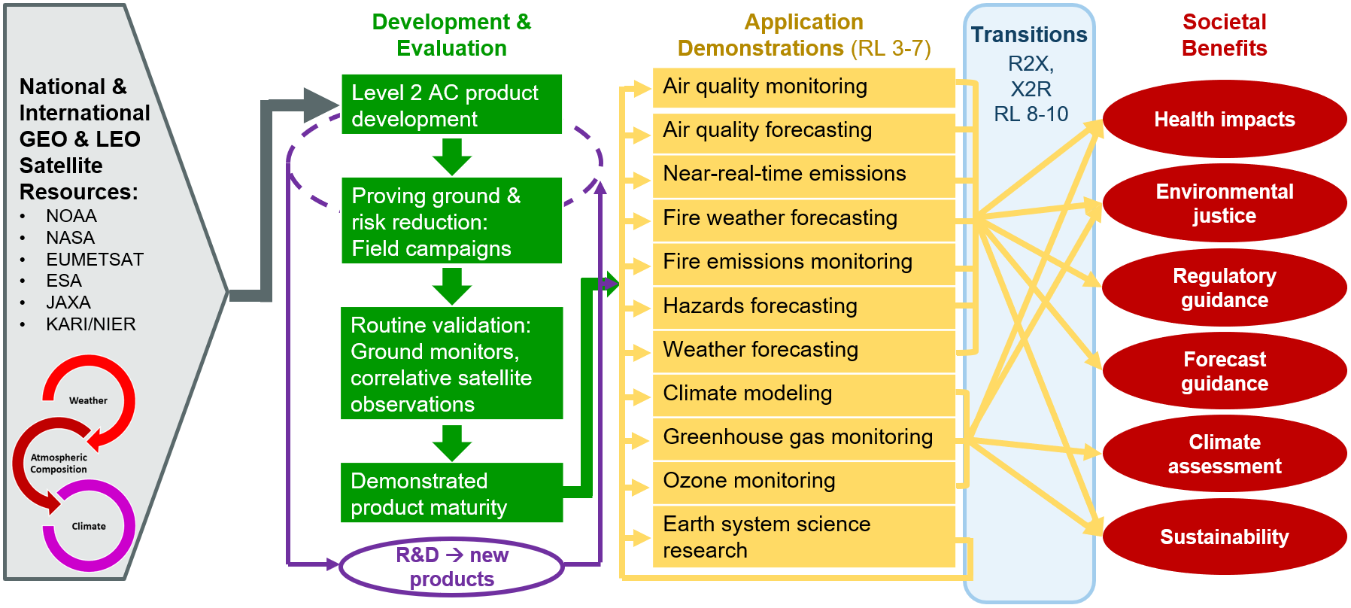
What new or enhanced partnerships should be engaged from TEMPO to GeoXO ACX?
Existing stakeholders
ACX science team
Data exploration
User engagement
User readiness
NOAA User Readiness Plan for Atmospheric Composition Observations from Space (NURPACS)

Slide 11



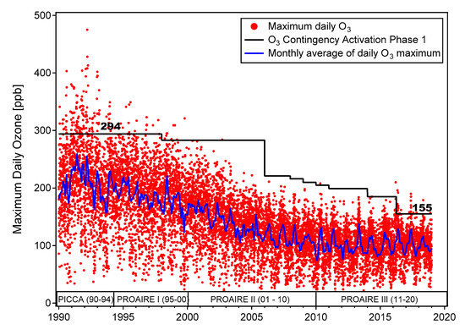
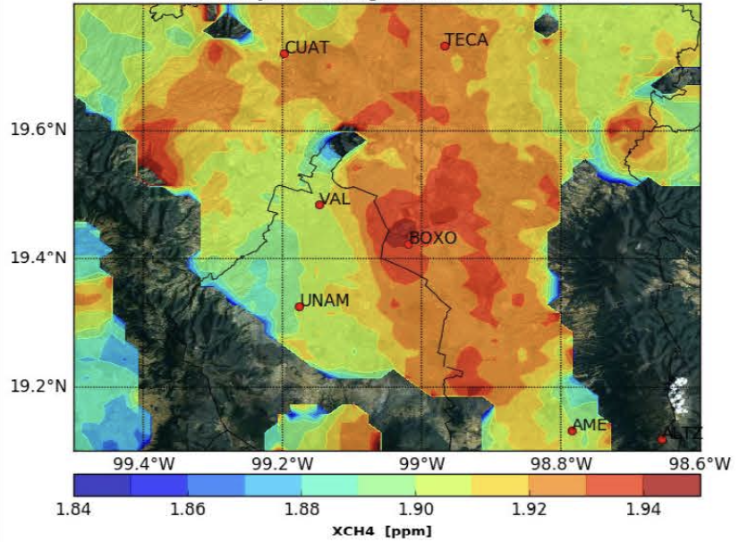
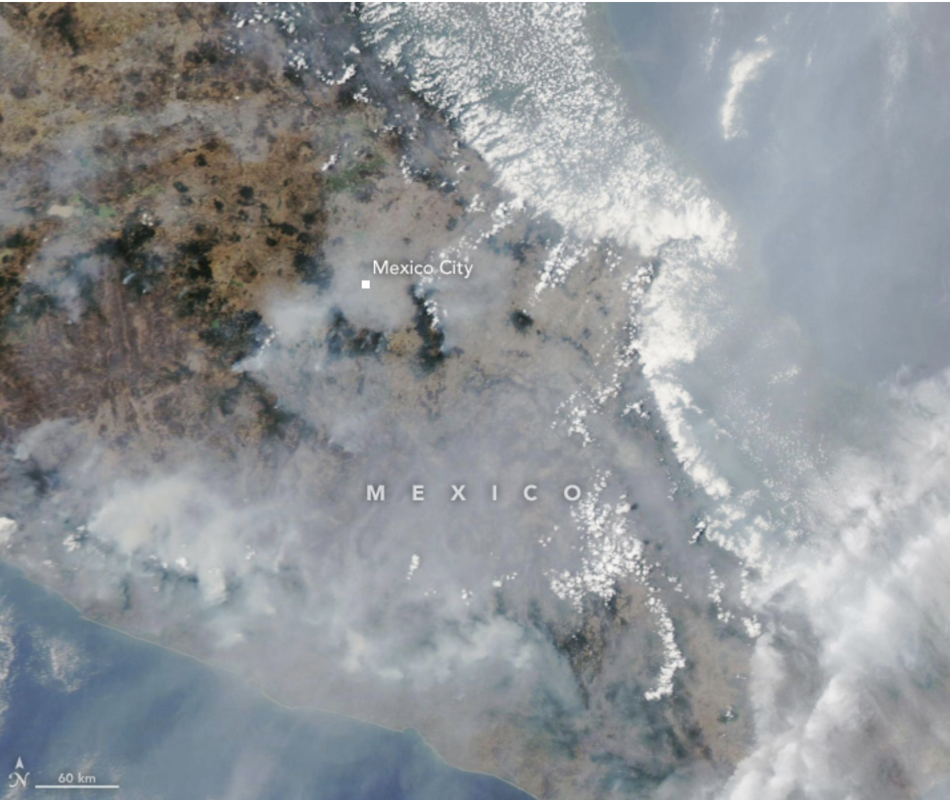
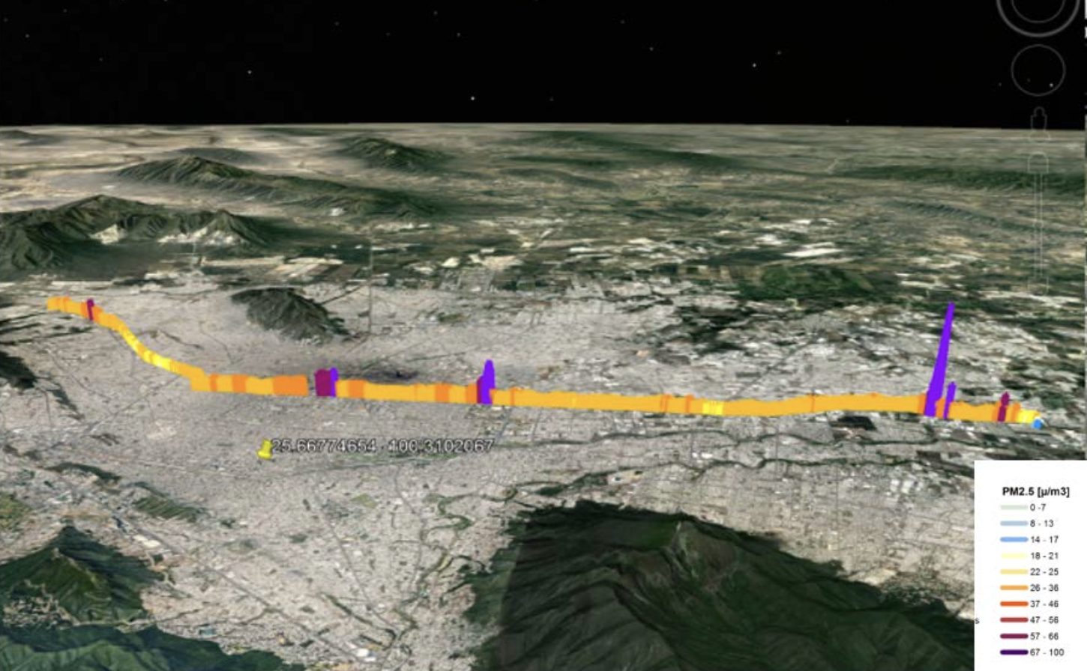
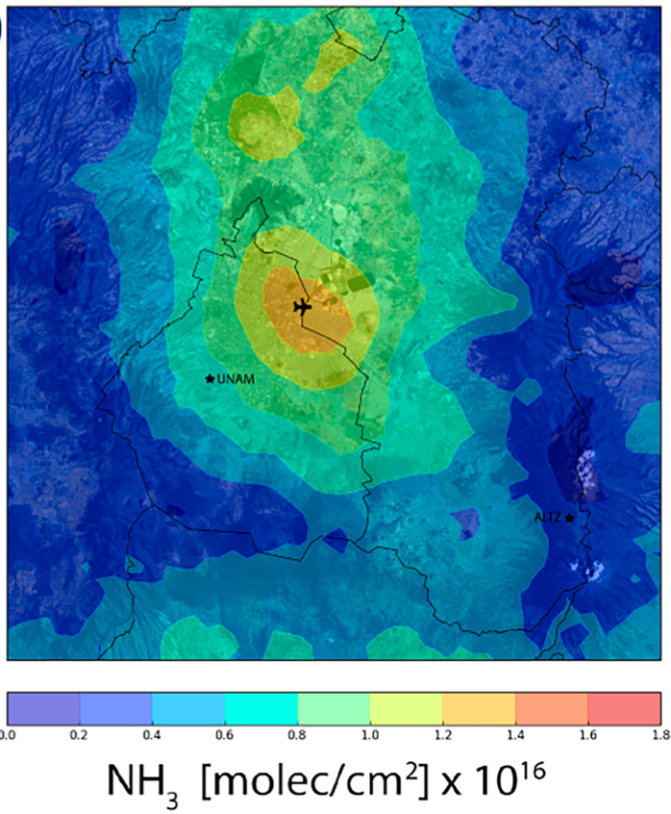
Paving the Future of Geostationary Air Quality Observations
Key issues
Challenge to reduce ozone in urban environments
Influence of industrual emissions (SO₂, NO₂, etc.) in cities
Transport of pollution events (wild and agricultural fires)
Impact of landfill / waste emissions (CH₄/NH₃) in urban AQ
Satellite-based PM2.5 predictions > impact on health, mortality, etc.
Ozone trends
in Mexico City
Molina et al. Atmosphere 2019, 10(9), 512
CH₄
Wildfires affecting AQ in Mexico City
PM2.5 hot spots in Monterrey
NH₃
Herrera et al. ACP 2022
May 2019
PM2.5 Report for Monterrey. CMM 2019
CH₄ and NH₃ distribution
in the MCMA: SOA formation

Slide 12
GeoXO User Engagement:
Meeting User Needs
Kat Hawley – GeoXO Lead Scientist for User Engagement
Andy Heidinger – NESDIS GEO Scientist
Pam Sullivan – GeoXO Program Director
Shobha Kondragunta, Greg Frost, Joanna Joiner – ACX Science Team Co-Leads
Dan Lindsey – GOES-R Program Scientist

Slide 13
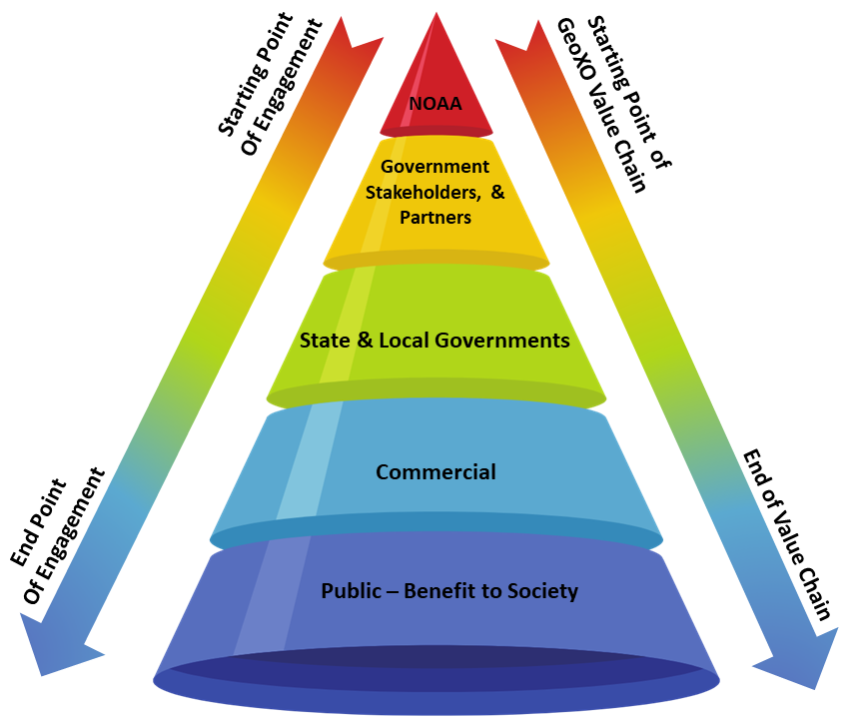
GeoXO User Engagement
User Engagement is an evidence-based discipline that helps us to learn about the needs, challenges, and work environment of those we serve so that we can provide the actionable, accessible, and impactful products and services to our customers - using a variety of social science and related strategies and techniques.

Slide 14











Stakeholders for NOAA’s Atmospheric Composition Products
Our Stakeholders
NOAA!!
Florida Department of Environmental Protection
Maryland Department of Environment
Clark County Department of Air Quality (Las Vegas, NV)
Connecticut Department of Energy and Environmental Protection
Forsyth County (NC) Office of Environmental Assistance and Protection
Operational forecasters for air quality and weather
Federal, state, & local environmental regulators
Climate, stratospheric, & air quality monitoring teams
Environmental assessment bodies
Public Health Officials & Diplomats
Research Community
Media
The American Public

Slide 15

User Driven Science
Hazards
Forecasting
Fire Emission
Monitoring
Weather
Forecasting
Fire Weather
Forecasting
Climate
Modeling
NRL
Emissions
Greenhouse Gas Monitoring
Societal Benefits:
Human Health Impacts
Environmental Justice
Regulatory Guidance
Forecast Guidance
Climate Assessments
Sustainability
Air Quality
Forecasting
Ozone
Monitoring
Air Quality
Monitoring
Earth-System
Research
User readiness planning is an end-to-end roadmap to develop new satellite products, evaluate them, demonstrate their use, and transition them into operations.

Slide 16
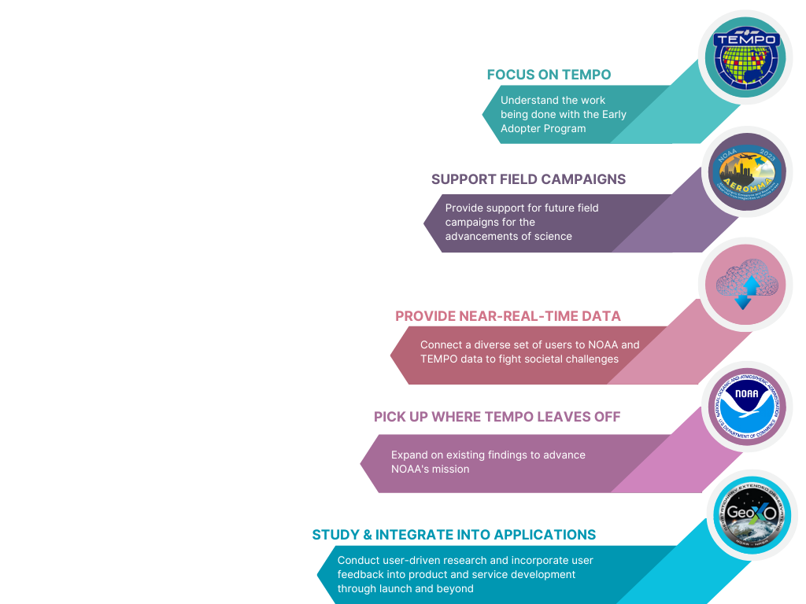

Our Path Forward

Slide 17
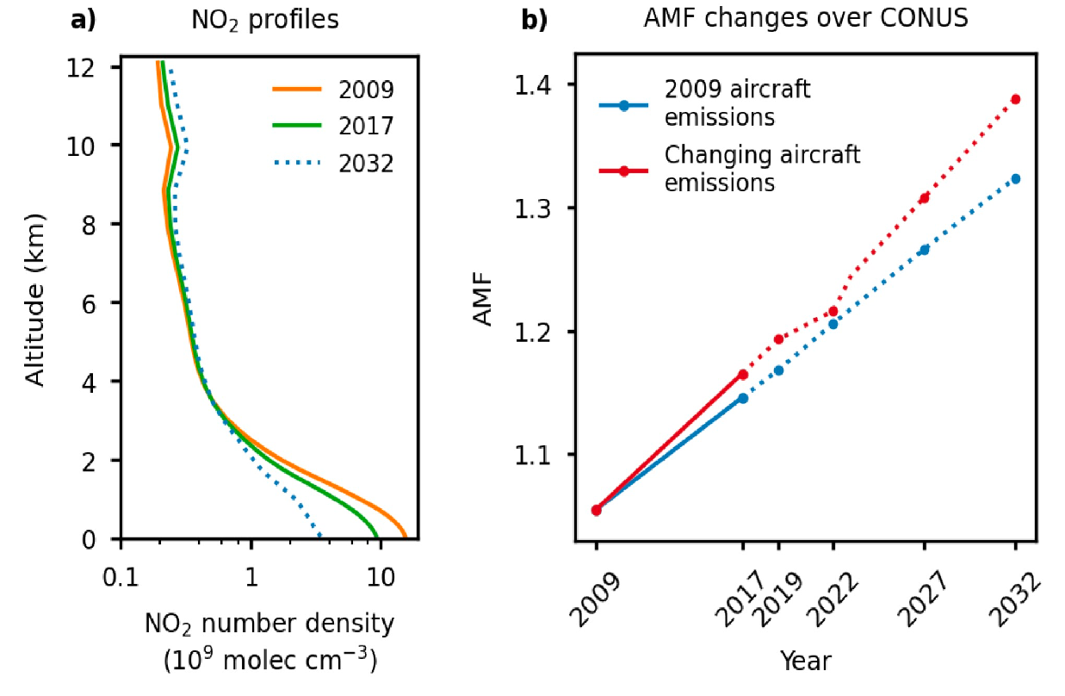

The coming decade will see rapid changes in US emissions that need to be monitored from geostationary orbit
Decreasing surface emissions; increasing aircraft, lightning, wildfires
Geostationary orbit has unique capability for cloud slicing to quantify and understand free tropospheric background
Monitoring of plumes from wildfires and other disasters can only be done effectively from geostationary orbit
Free tropospheric NO₂:
- lightning
- aircraft
- fires
- organic nitrates
- NO₃⁻ photolysis
FT:
70-80%
presently accounts for ~70%
of tropospheric NO₂ VCD over US
Will likely increase over next decade…as surface contribution decreases
PBL:
20-30%
Daniel Jacob
Dang et al., https://doi.org/10.5194/egusphere-2022-1198

Slide 18
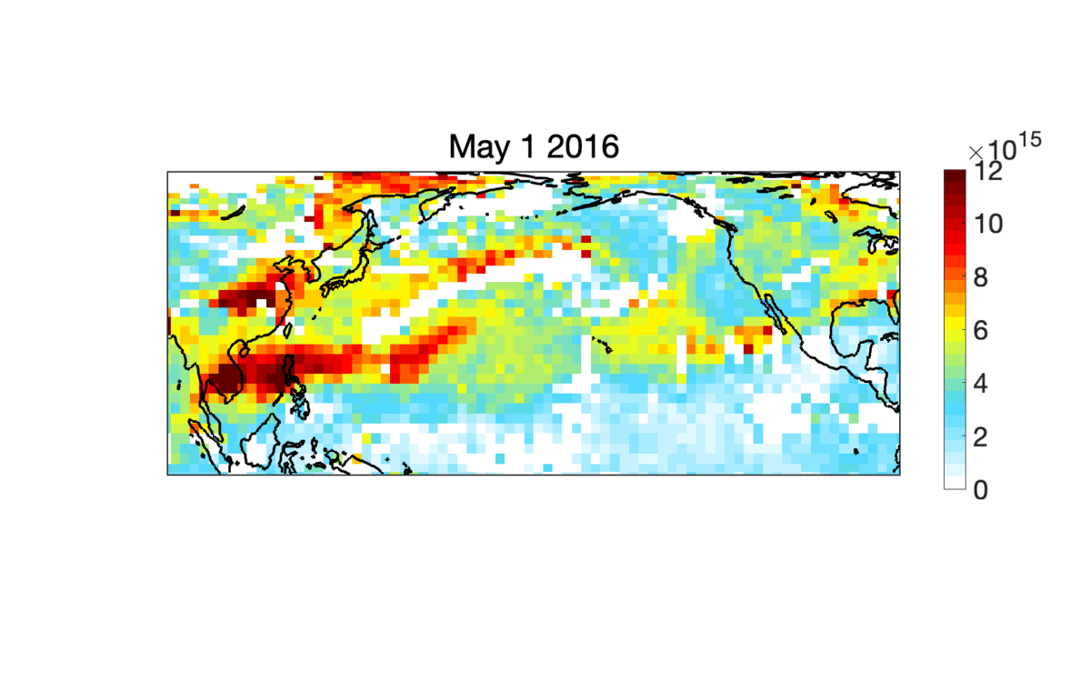
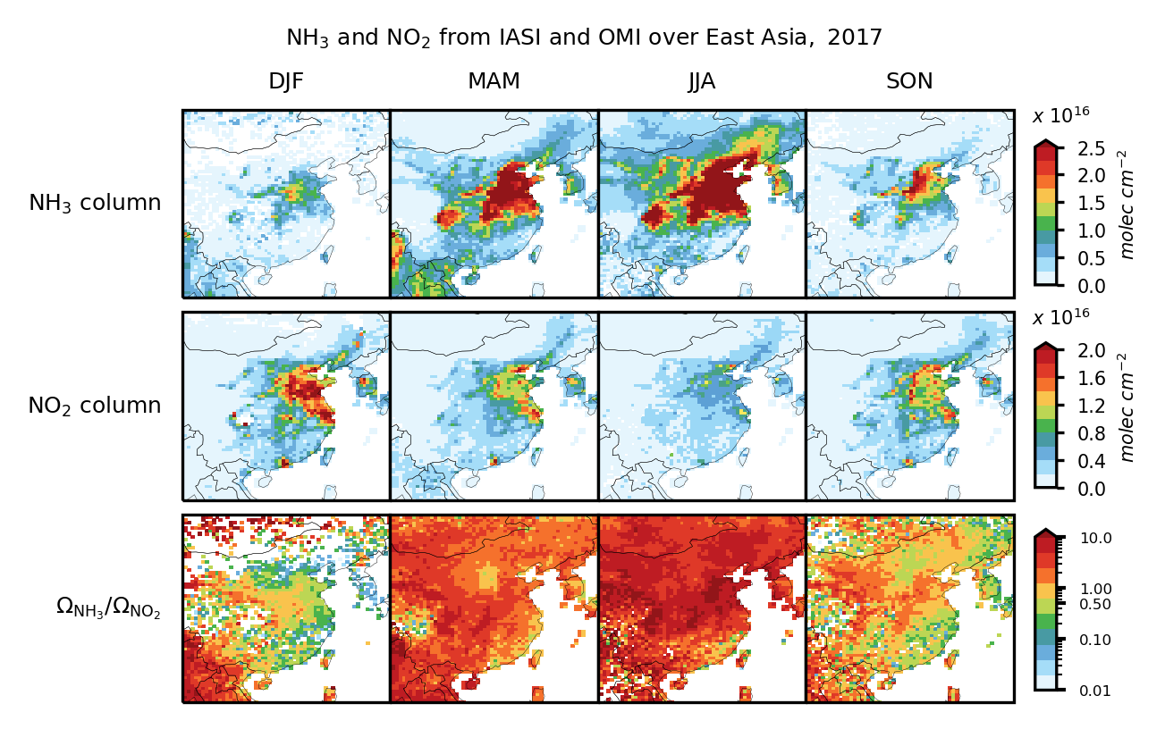
Future geostationary AQ measurements should include TIR observations to cover a range of important species
TIR is needed to observe NH₃, PAN, isoprene, other VOCs
NH₃/NO₂ ratio can diagnose chemical regime for nitrate PM_{2.5} formation
PAN can be unique resource to track intercontinental ozone pollution
Europe will have geostationary TIR IRS instrument launched with Sentinel-4
TIR observes wide range of gases to track plumes from major accidents
NH₃/NO₂ winter ratio from IASI/OMI
IASI PAN
NH₃-
limited
NO_{x}-limited
Daniel Jacob
Ruijun Dang and Shixian Zhai (Harvard), in prep.

Slide 19
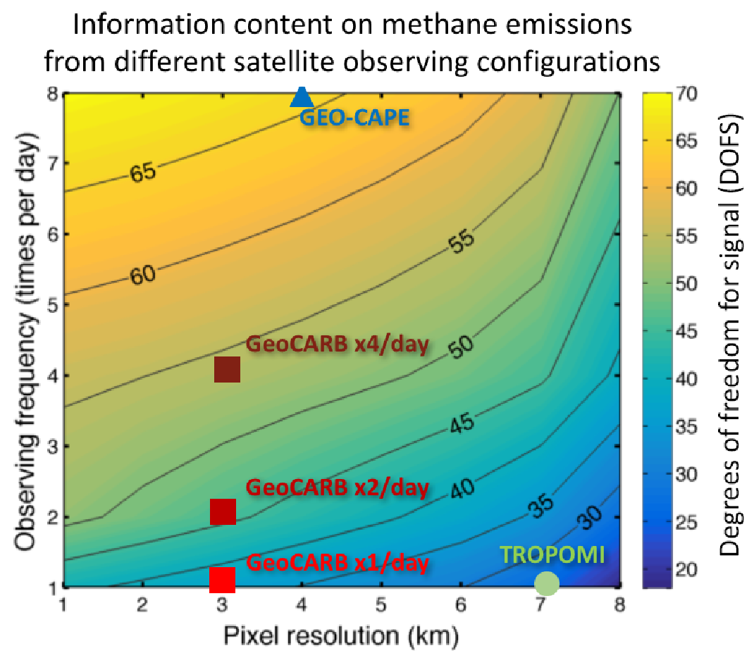
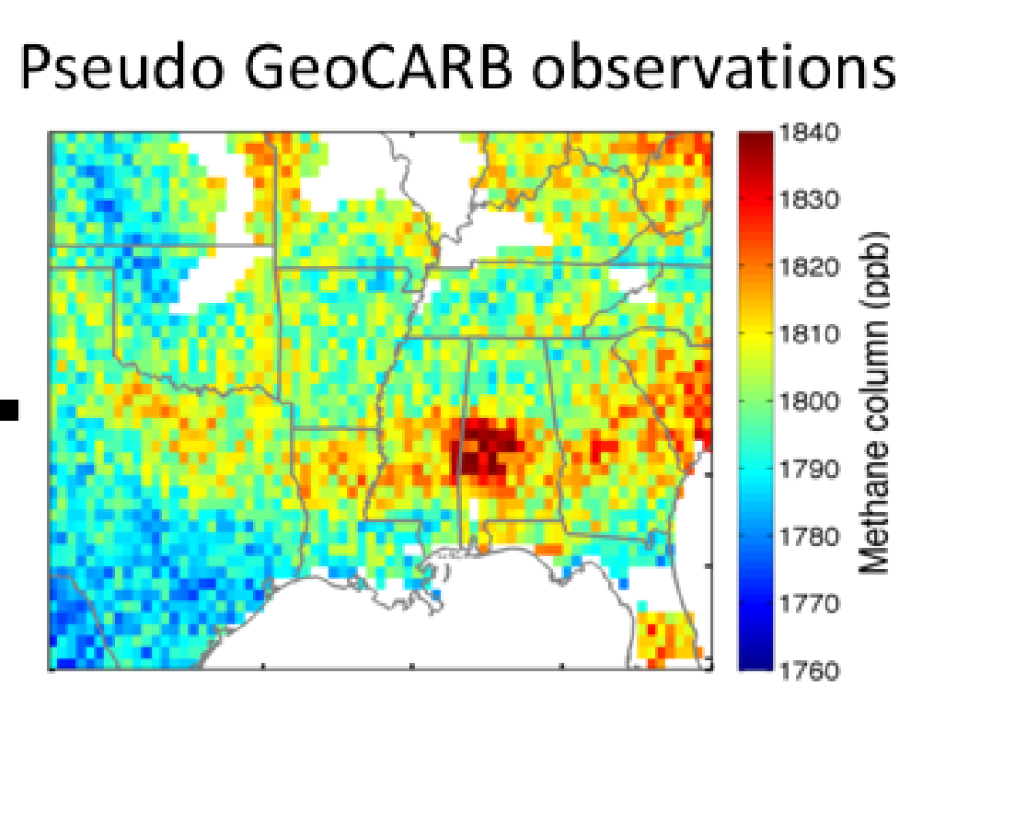
Future geostationary AQ instruments should include SWIR observations of greenhouse gases
Air quality managers increasingly need to manage greenhouse gas fluxes
Huge need for top-down observations of methane, rising need for CO₂ (carbon sequestration, biospheric fluxes)
Geostationary orbit is of unique value for intermittent emissions (methane), diurnal cycle (CO₂)
We lost GeoCARB, let’s design it better to have hourly observations over national/continental scale
13:00 on 8/12/2013
Daniel Jacob
Sheng et al., Atmos. Meas. Tech., 11, 6379–6388, 2018

Slide 20
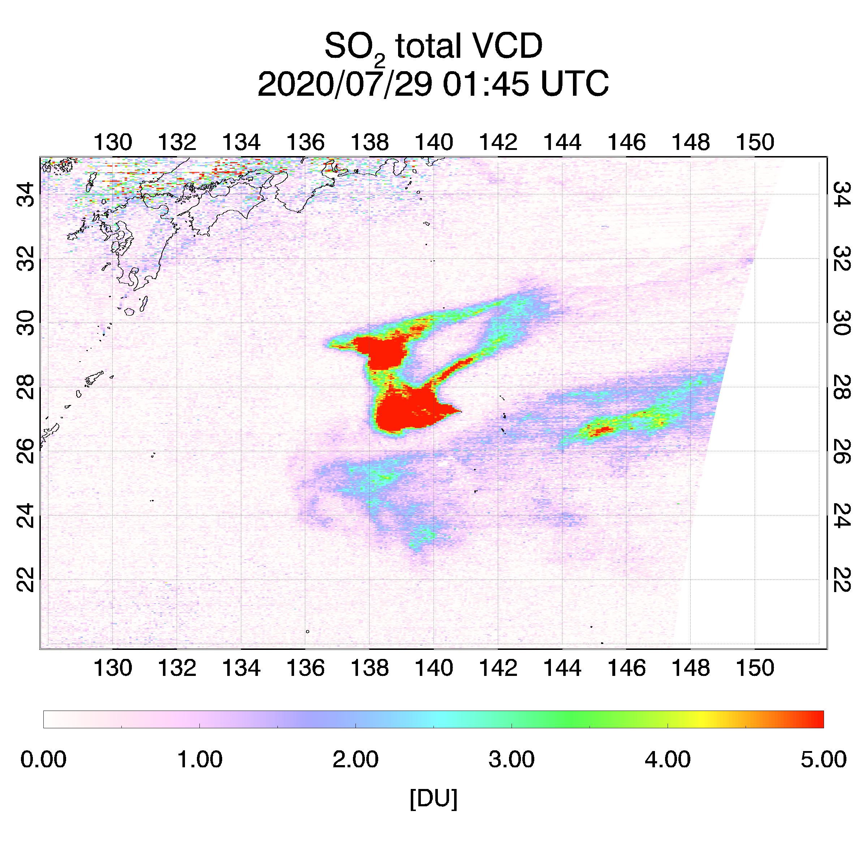
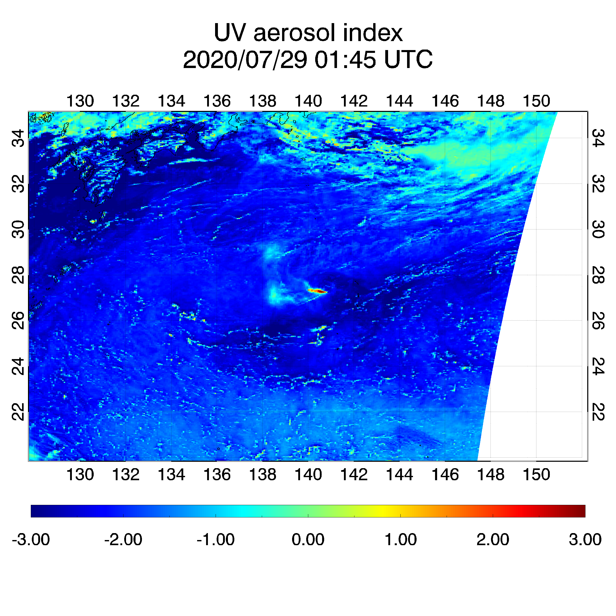
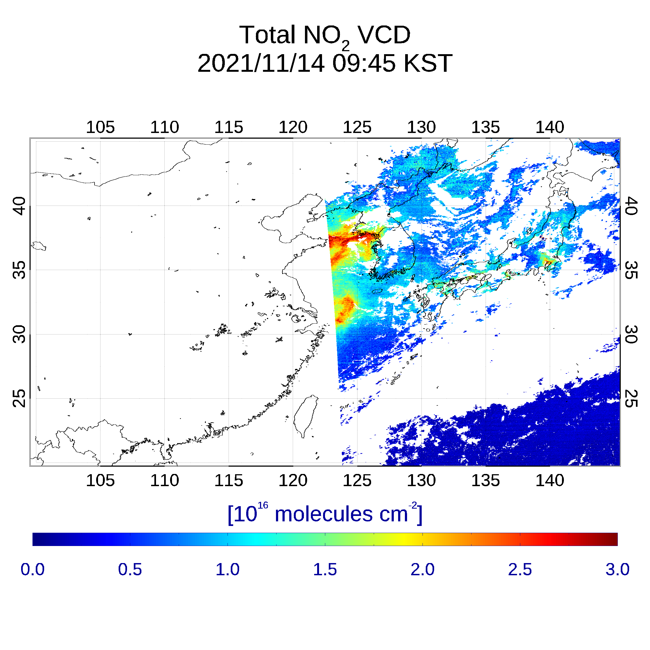
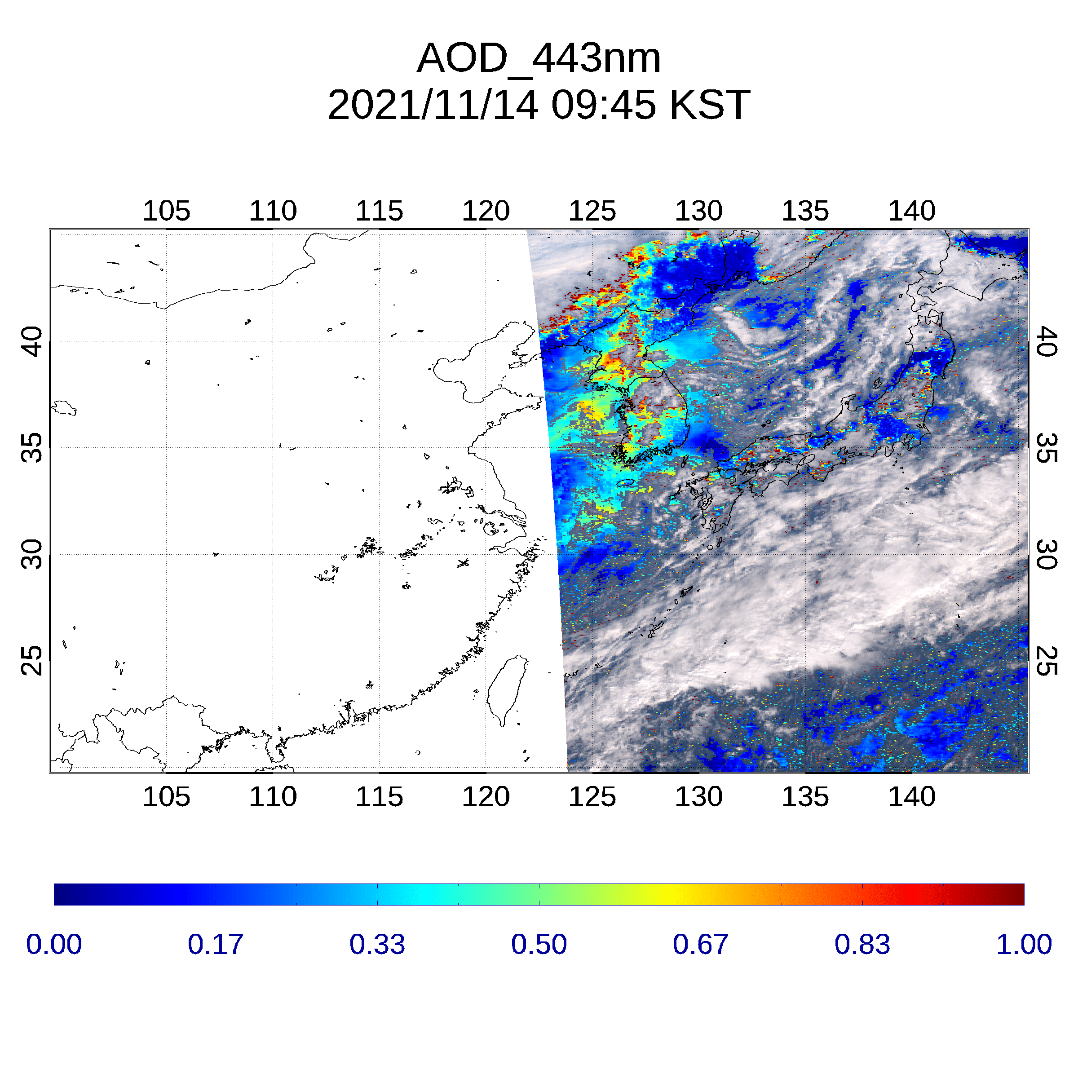
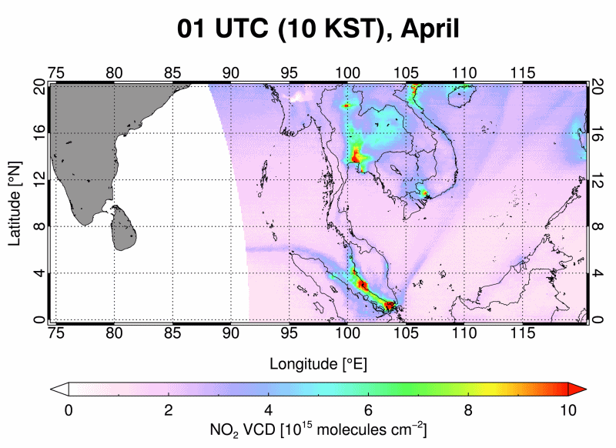
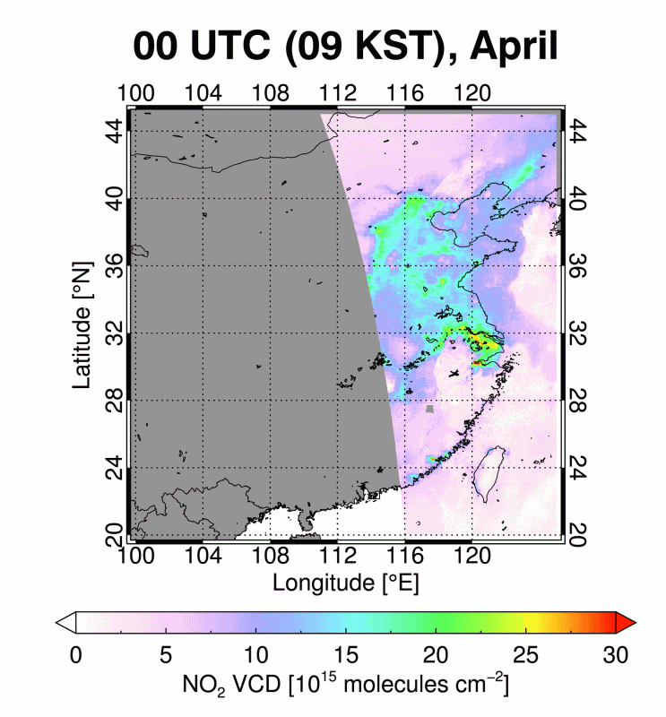
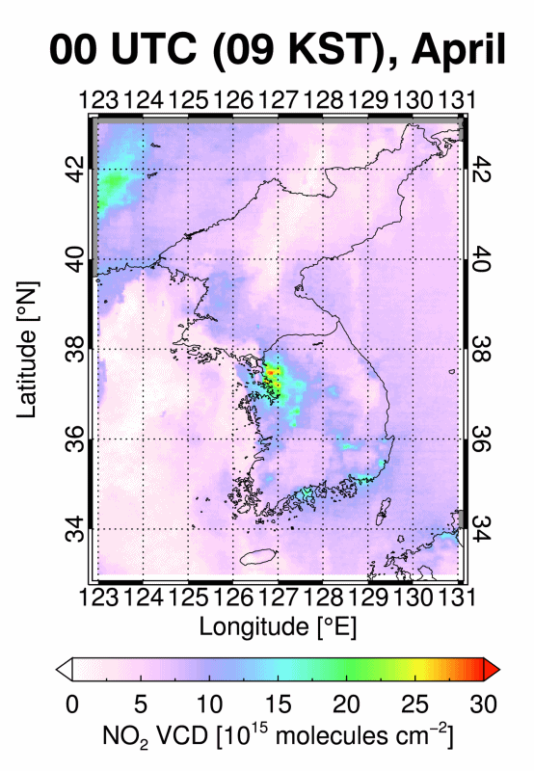
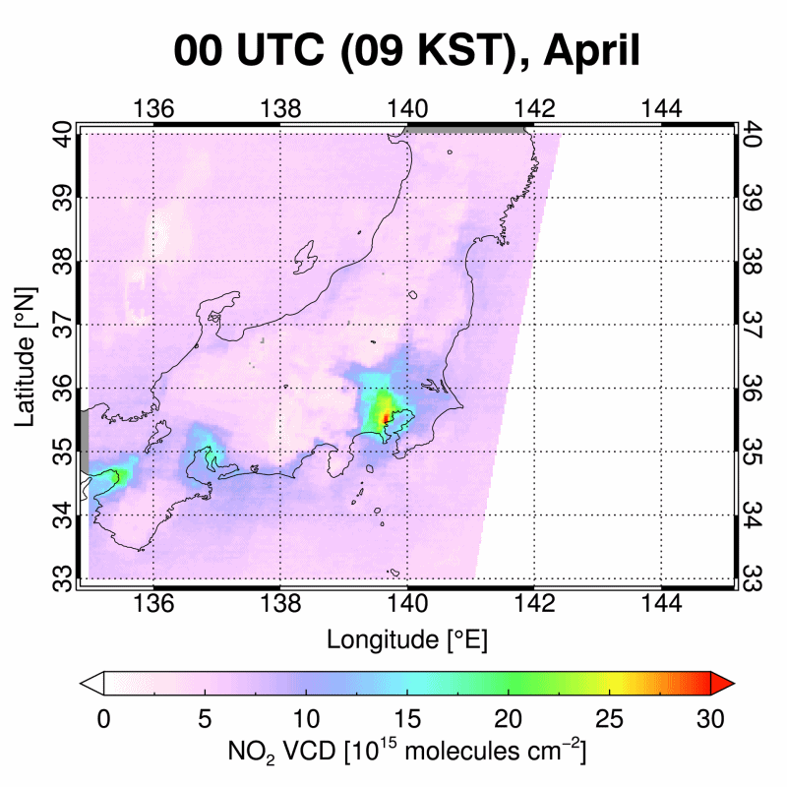
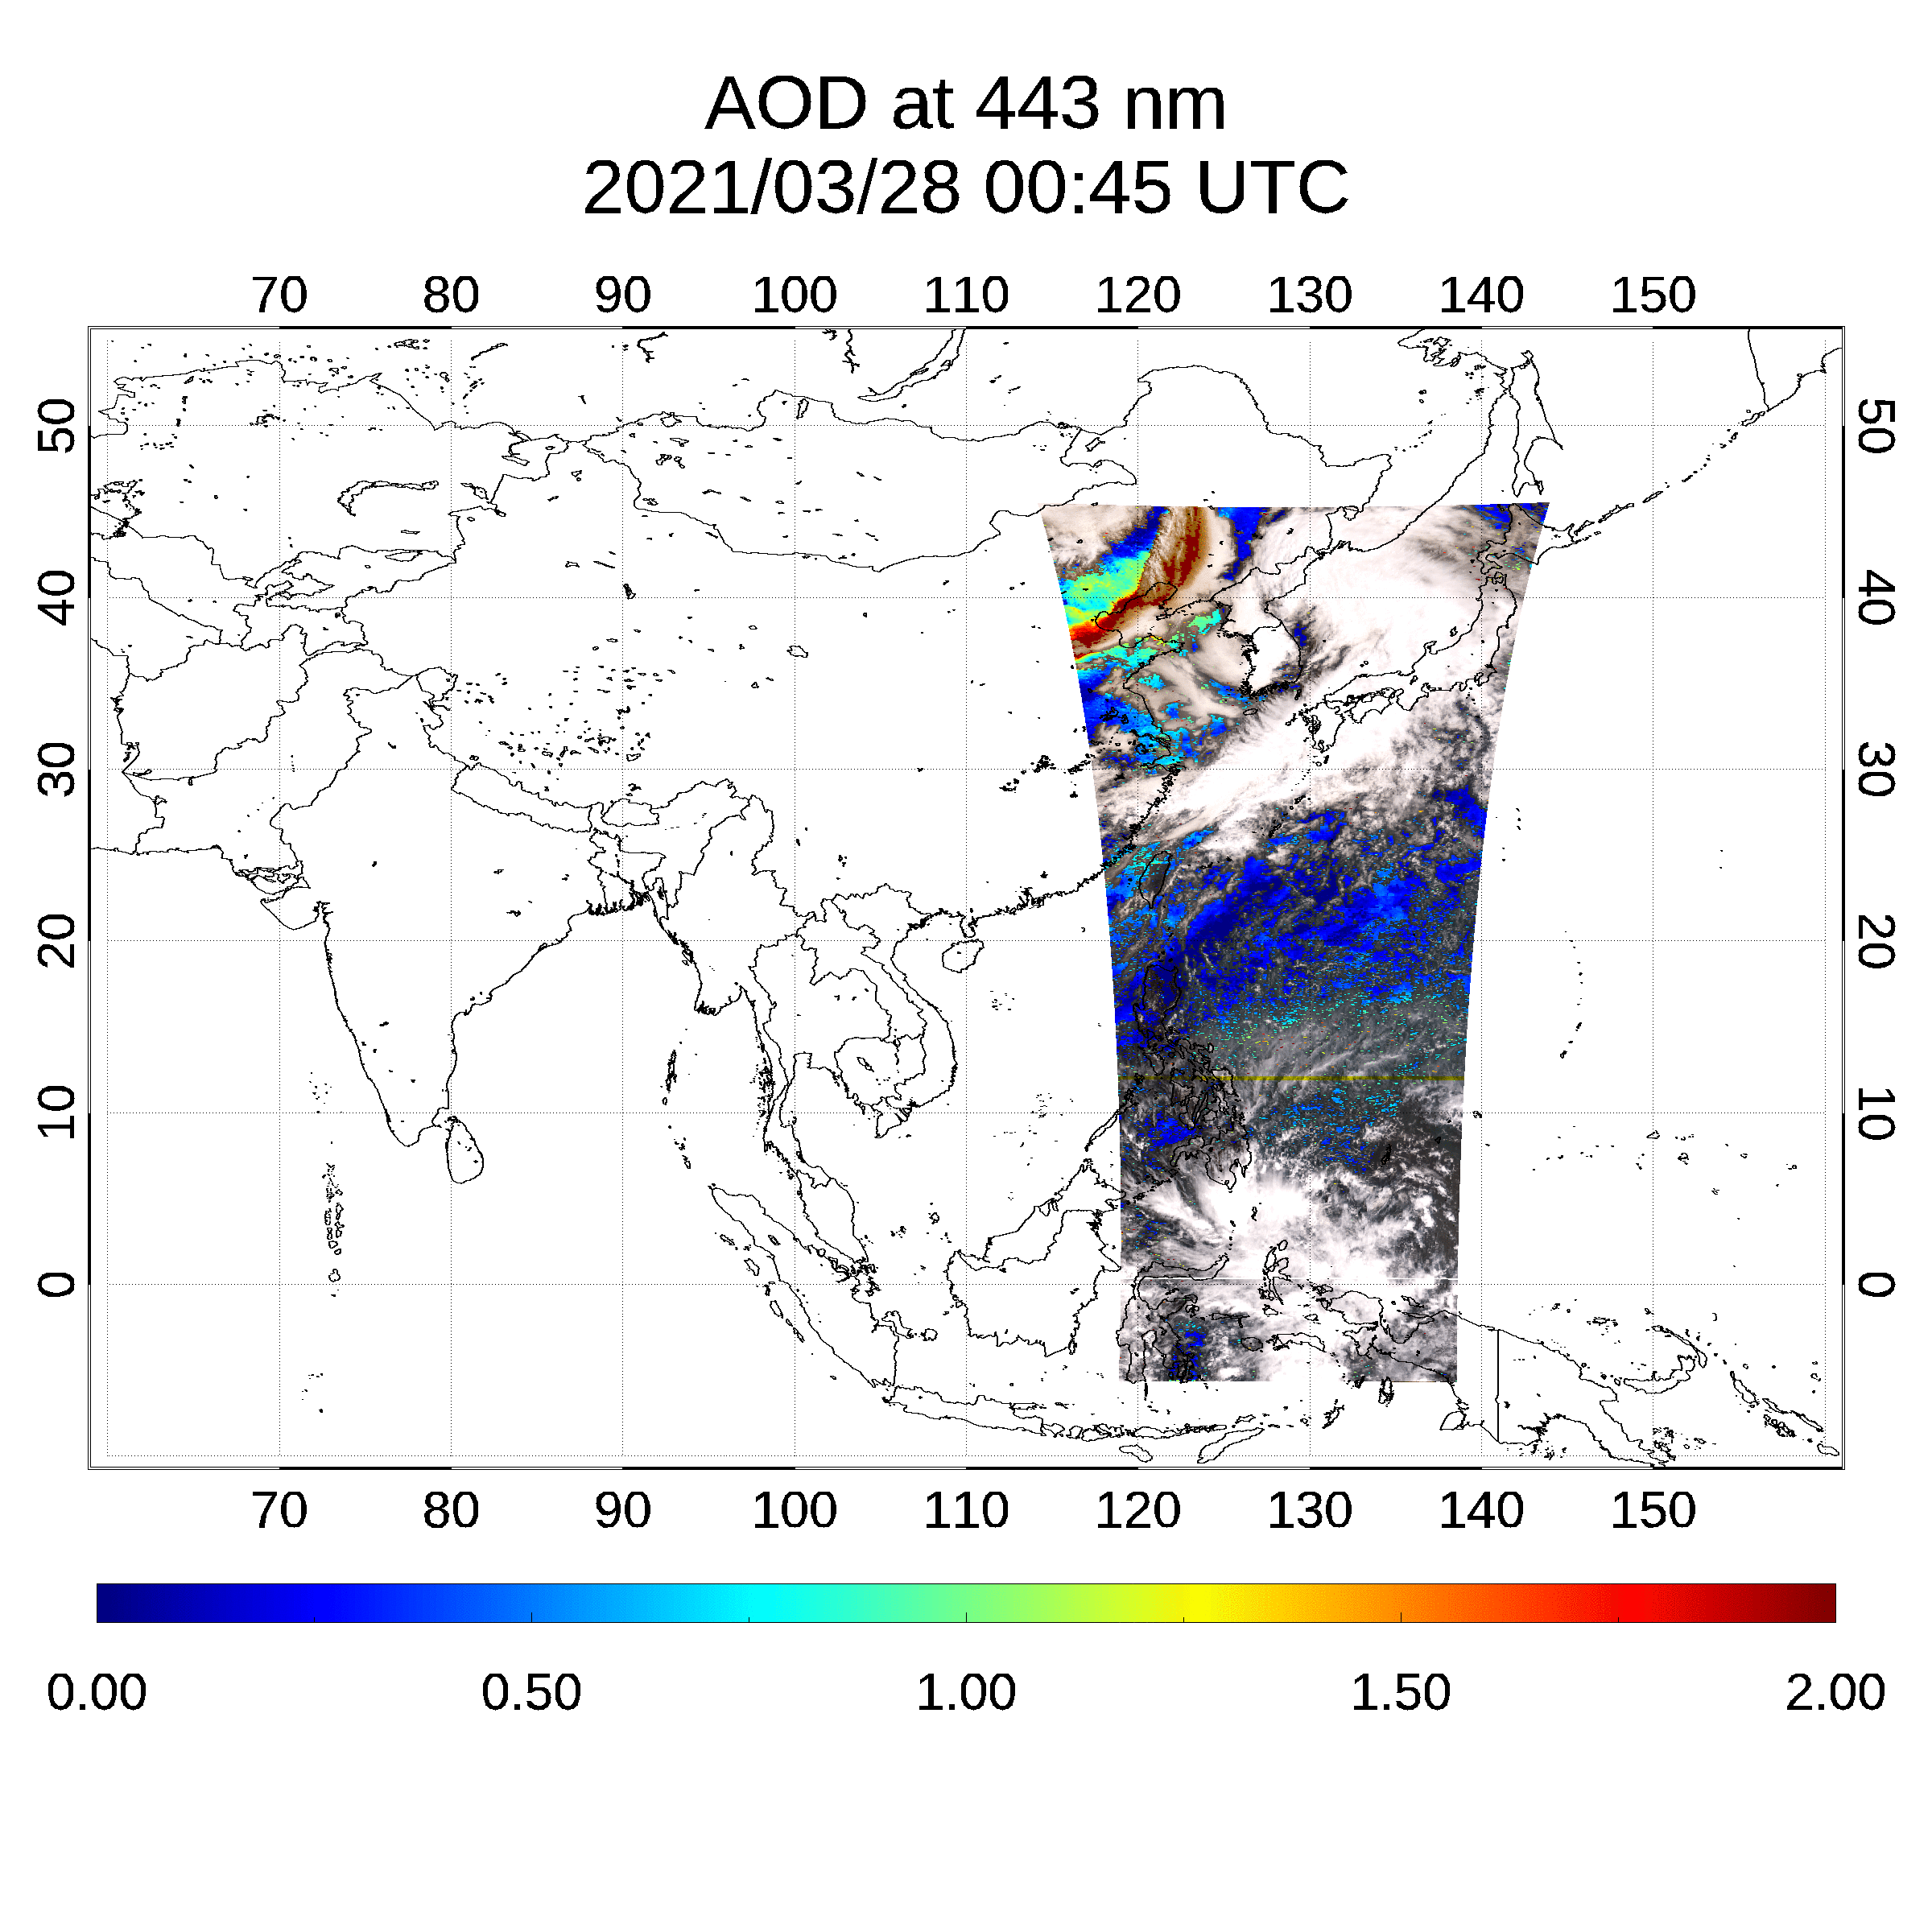
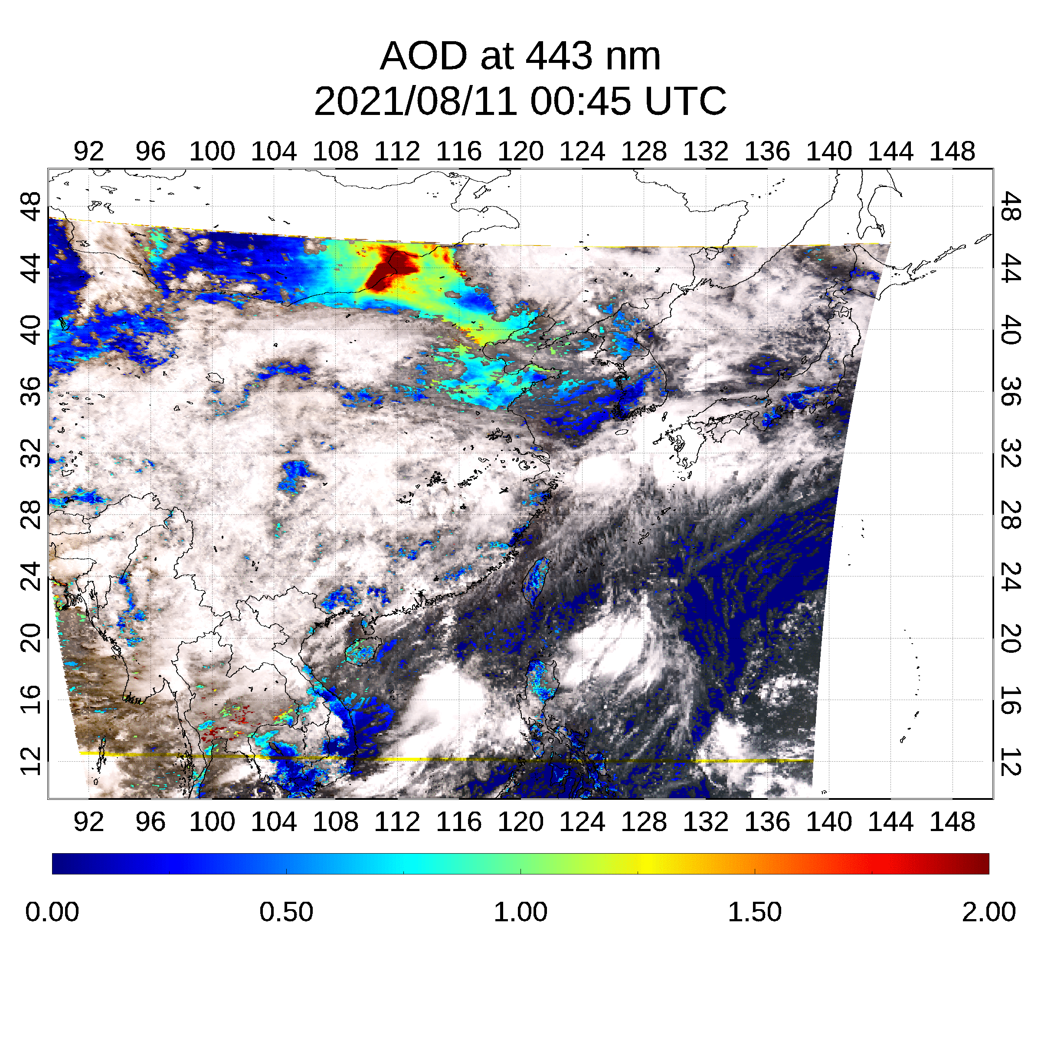
Air quality observations from GEMS
Volcanic eruption on Jul 29, 2020
(SO₂ & aerosols)
Long-range transport on Nov 14, 2021
(NO₂ & aerosols)
Ship emissions in Apr 2021
(NO₂)
Port Klang
(Malaysia)
Singapore
Megacity emissions
(NO₂)
Dust event on Mar 28, 2020
(Aerosols)
Wildfire on Aug 11, 2021
(Aerosols)
Beijing
Shanghai
Seoul
Nagoya
Hongkong
Tokyo
Osaka

Slide 21
Development of satellite remote sensing instruments
week
OMI(1)
VIIRS(1)
TROPOMI(1)
OMPS(1)
MODIS(1)
CrIS(1)
AIRS(1)
LEO
SGLI(3)
3MI(1)
GMI(5)
SCIAMACHY(3)
EMI(1)
GOME-2(1.5)
day
GOSAT
GOME(3)
OCO-2,
TANSAT
MISR(9)
TOMS(1)
MAIA(T)
TES(16)
MOPITT(5)
TEMPO
IASI (1)
SeaWiFS(1)
GeoCarb
GOCI
GEMS
EPIC(L)
Temporal Resolution
hr
GOCI-2
Sentinel-4
GEO
SEVIRI
INSAT-3D
(IMAGER)
Aerosol
Purple : UV-Vis
Yellow : Vis/NIR
Gray : single Vis
AGRI
AHI
ABI
AMI
min
FCI
MTSAT
GOES-8 (IMAGER)
Trace Gases
GeoXO
Purple : UV-Vis
Yellow : Vis/NIR
Red : IR
White : UV-IR
MI
(T): target area observations
(L): Lagrangian point (L1)
Italic & dashed line: to be launched
GHG(CH₄,CO₂)
0.1
1
10
100
1000
Spatial Resolution (km)
[Kim et al. (BAMS 2020)]

Slide 22
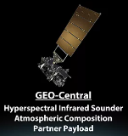
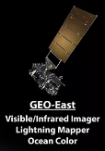
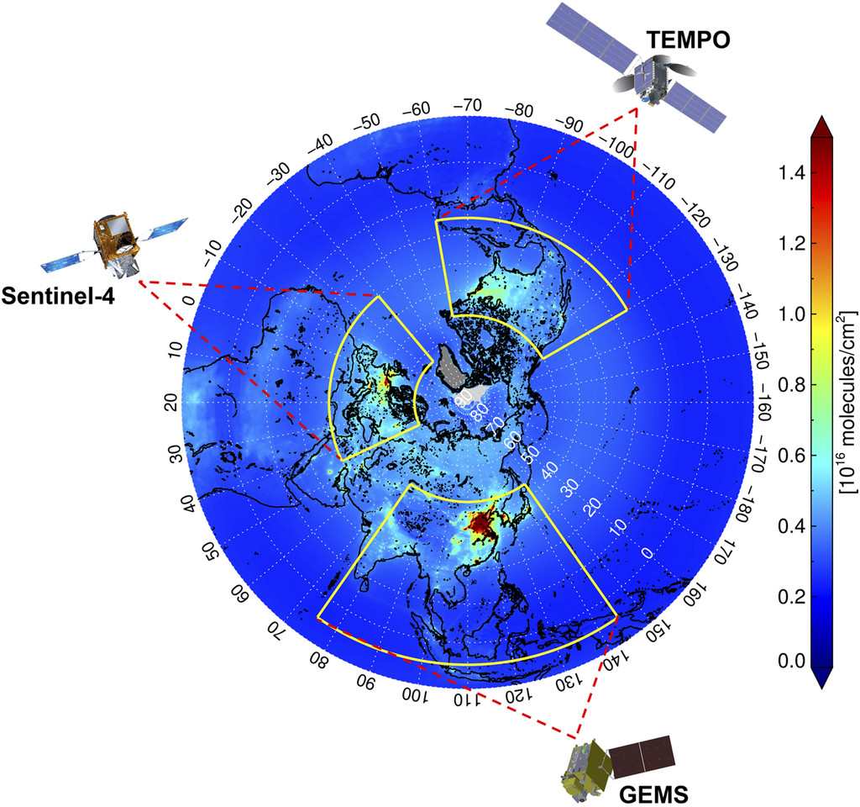
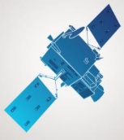
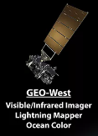
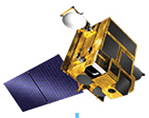

GEO Air Quality + Met + OC Constellation
Era of GeoXO & TEMPO 2
Wider spatial coverage including Southern Hemisphere
Higher spatial resolution up to < 1 km
Higher spectral coverage including IR
- TEMPO + IASI + GeoCarb
capability
Higher temporal resolution up to 5 minutes
Air Quality + Met + OC
+ Public Health
Faster & frequent update of top-down emission inventory
Revolutionize physical & chemical weather forecast, early warning system etc,
GeoXO E
GeoXO C
MTG
MFG..
FCI
GeoXO W
[Kim et al. (BAMS 2020)]
GOCI3
AMI2
2

Slide 23
Session III: TEMPO / GeoXO Joint Pannel
Diego Loyola (DLR)

Slide 24
GEO – LEO Intercalibration
Intercalibration of the GEO Atmospheric Composition Constellation sensors using LEO spectrometers (UVN)
GEO AC first generation: GEMS, TEMPO, Sentinel-4/MTG-S1
LEO: early afternoon: TROPOMI, OMPS morning: GOME-2/Metop-B & C
GEO AC second generation: GEMS?, Sentinel-4/MTG-S2, ACX/GeoXO
LEO: early afternoon: TROPOMI, OMPS morning: OMS, Sentinel-5/Metop-SG A1 & A2 & A3
Develop open science tools for GEO-LEO intercalibration:
Collocation (temporal and spatial) and matching (viewing geometry, ISRF adjustment)
Target selection (dessert regions, dark ocean, convective clouds, …)
Automatic comparisons, trend analysis, etc.

Slide 25
Synergies with collocated Sensors
Imagers used for L1 and geolocation verification, cloud masking, joint retrievals, etc.
GEMS: AMI/GK-2A, GOCI-2/GK-2B
TEMPO: GOES
Sentinel-4/MTG-S: FCI/MTG-I
ACX and GXI onboard GeoXO
Infrared Sounders used for L2 comparisons, joint retrievals, etc.
Sentinel-4 and IRS onboard MTG-S
ACX and GXS onboard GeoXO

Slide 26
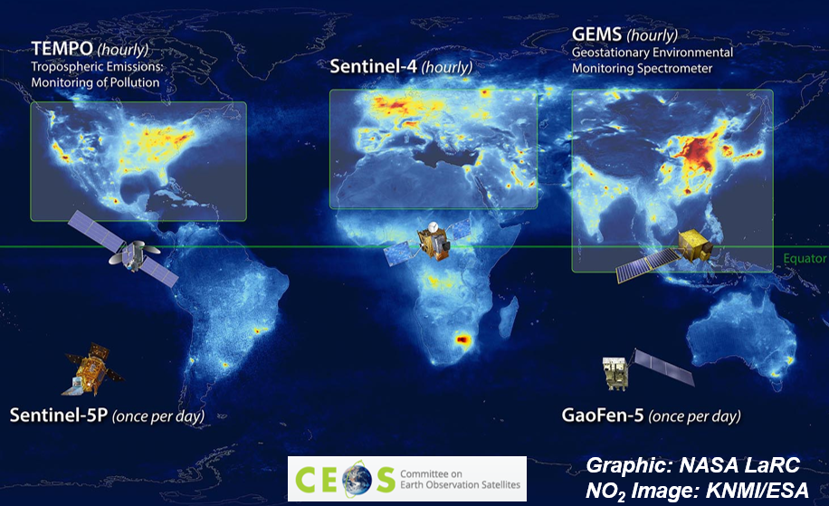
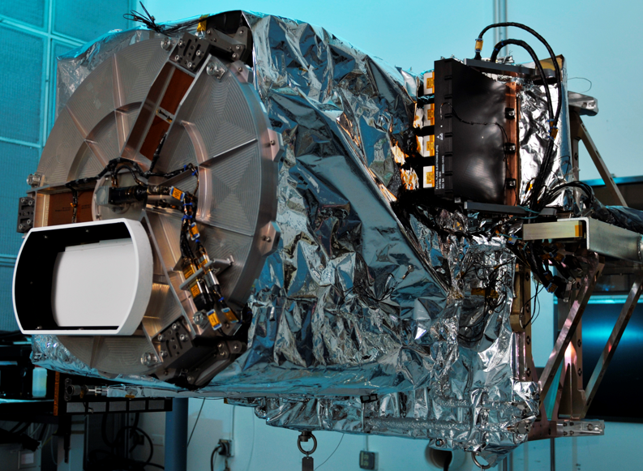
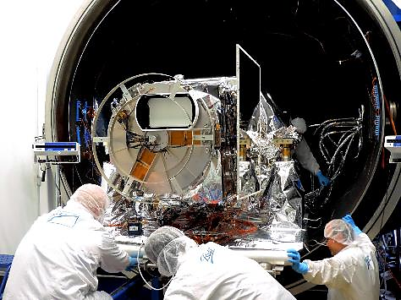



BALL’S ROLE IN REALIZING HOURLY ATMOSPHERIC COMPOSITION FROM GEO
2024 Launch
Launched 2020
Operational
2023 Launch
CEOS ATMOSPHERIC COMPOSITION VIRTUAL CONSTELLATION WILL BE REALIZED IN 2024

Slide 27

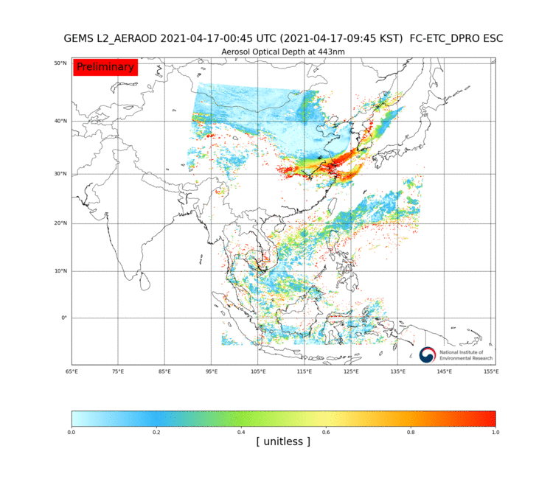
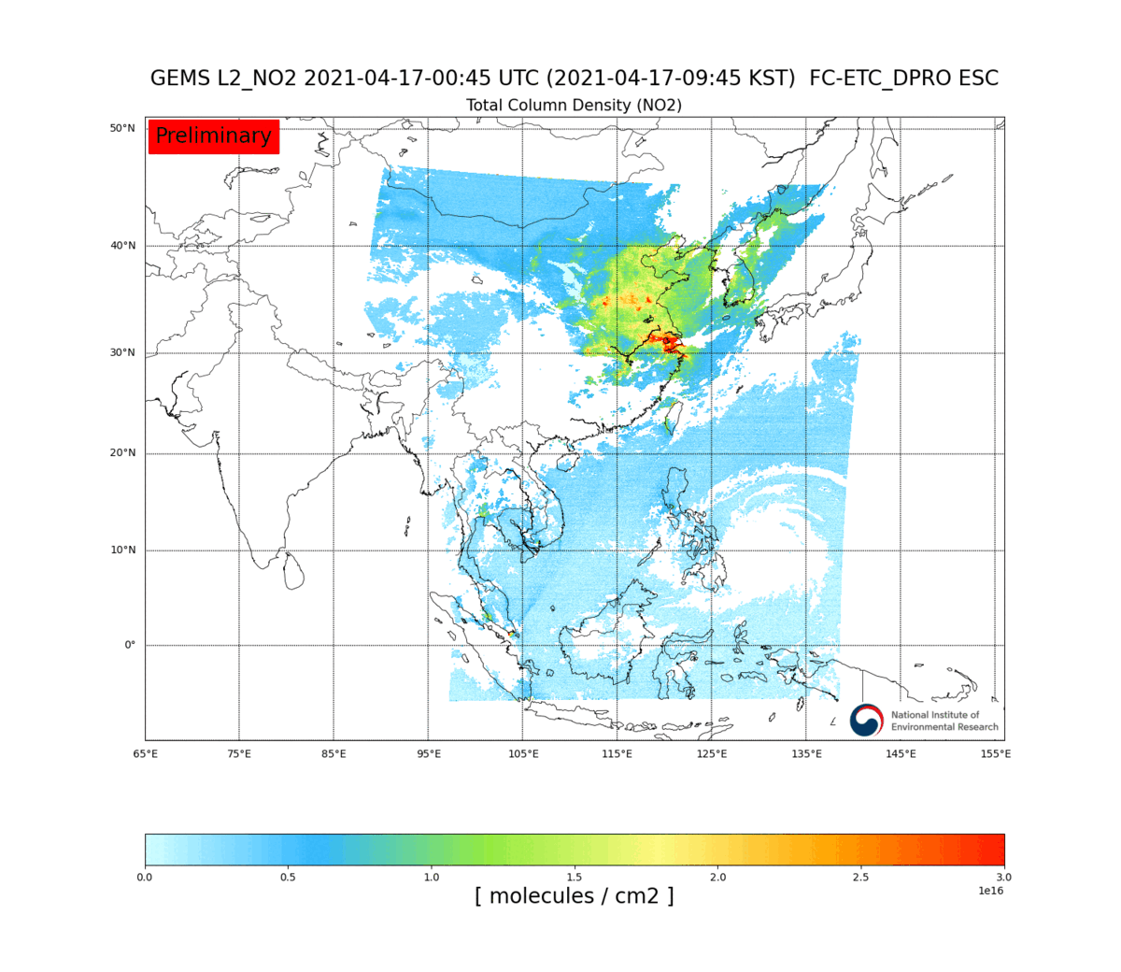
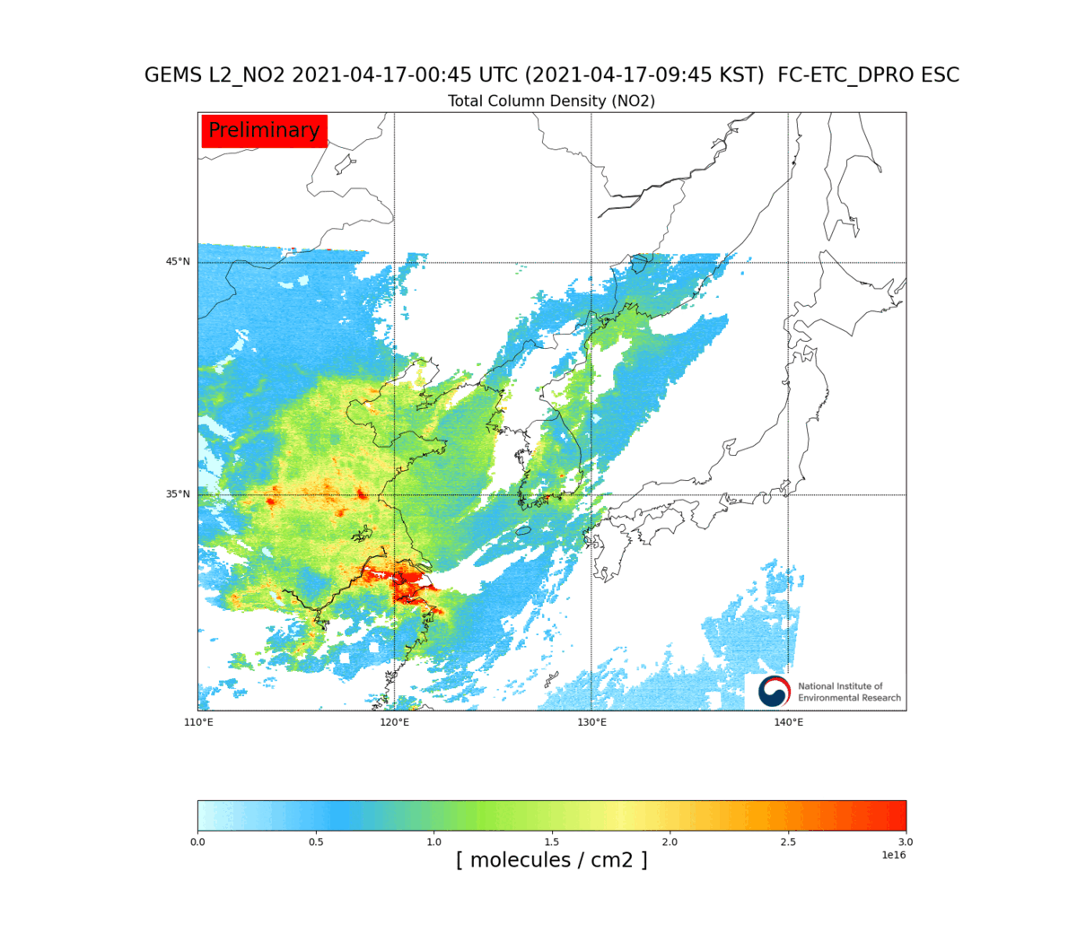
GEMS HOURLY ATMOSPHERIC COMPOSITION MEASUREMENTS
April 17, 2021 Mongolian dust event (AOD 443nm)
April 17 2021– NO₂ pollution transport

Slide 28
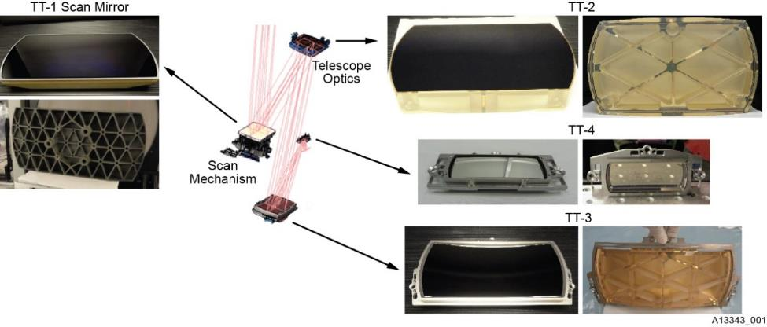
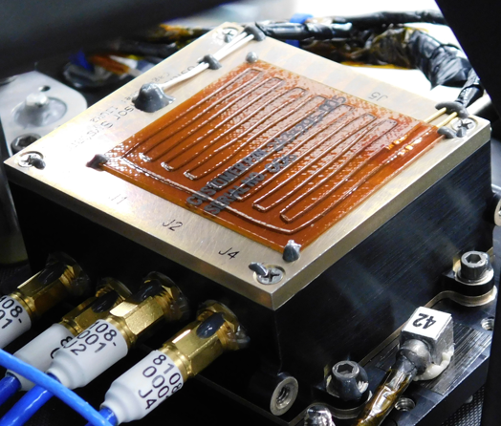

TEMPO CONTINUITY MISSION / ACX PRECURSOR: ASSURING DATA CONTINUITY
Spares from GEMS & TEMPO available for a continuity mission
Long lead would be EEE parts
Focus on manufacturing, assembly & test
Hosted, or free-flyer option
Ground Processing infrastructure in place
Science data processing
Command, control & telemetry monitoring
Delivery of data products to NOAA
Science infrastructure is ready
TEMPO Early Adopters
For 2029 mission launch, need to start planning now

Slide 29



How best can we shift from Early Adopters to Pathfinders?
GeoXO & Pathfinders are off to a great start! Assessing end-user & stakeholder needs and insights early in mission lifecycle is critical for broadening & enhancing applications and societal impacts of satellite data.
We have done a lot of work to document needs and insights from the TEMPO Early Adopters in workshop reports and publications. GeoXO and Pathfinders Program can leverage this information.
Leverage growing list of super users in TEMPO Early Adopters Program, especially as the program shares impact stories from their application of operational TEMPO data.
TEMPO Early Adopters Program in conjunction with Satellite Needs Working Group will continue to assess end-user and stakeholder needs during nominal operations of TEMPO. Provide this feedback to GeoXO and Pathfinder team.
‹#›

Slide 30
How best can we shift from Early Adopters to Pathfinders?
The Early Adopters Program started off with mostly NASA and Academia partners. Participation from U.S. State, local, and tribal air agencies has grown dramatically in past several years.
Pathfinders Program should closely engage these critical air agency partners along with private & commercial partners early in mission lifecycle to tailor products and tools to end-users / stakeholders
I envision our GEO air quality satellite data being used to the same degree as satellite data in the weather forecasting community now. Integrating those operational partners in the Pathfinders Program will help achieve this!
Provide funding for Pathfinders! Can an initiative similar to NASA HAQAST be integrated into the GeoXO and Pathfinder program in early mission phase.
~ 420 Early Adopters (as of early April 2023), includes federal, state, local, & tribal air agencies, health organizations, and NGOs
‹#›

Slide 31
How best can we shift from Early Adopters to Pathfinders?
Operational Water Vapor Assimilation
Multi-Pollutant Data Assimilation
AQ Forecast Support & Evaluation
Build off applications and Green Paper experiments in the TEMPO Early Adopters Program
We have a number of Early Adopters in each of these application areas.
Highlight impact stories from use of TEMPO data in each of these application areas and share with GeoXO and Pathfinders Program.
Forecasting Weather Disasters
Weather Analysis & Forecasting
Air Quality Modeling & Forecasting
Harmful Algal Blooms
Estimating Emissions
Vegetation & Ocean Monitoring
Air Pollution Emissions & Monitoring
Monitoring Air Quality Disasters
Ozone-induced crop damages
Public Health
Regulatory Science
Exceptional Event Demonstrations
Short-term Exposure Assessments
Daily UV Exposures
Assessing Long-term Pollutant Trends
‹#›

Slide 32


Day 1 Session III: TEMPO/GeoXO Joint Panel
Brad Pierce
University of Wisconsin - Madison
Joint Science Meeting for TEMPO, GeoXO ACX, & TOLNet, May 1-5, 2023, University of Alabama in Huntsville

Slide 33


How can we ensure the continuity of measurements from TEMPO to GeoXO ACX?
Expand the Pandonia Global Network
Like AeroNet, which has been the key validation data for MODIS, VIIRS, and ABI aerosol optical depth retrievals, PGN data will be the key validation data for TEMPO, and GeoXO
Differences in the footprints of satellite and surface remote sensing measurements requires long time series at many locations to perform meaningful validation activities.
https://www.pandonia-global-network.org/

Slide 34


What new or enhanced partnerships should be engaged from TEMPO to GeoXO ACX?
A UV-VIS Component of the Global Space-Based Inter-Calibration System (GSICS) needs to be developed
GSICS is an WMO sponsored international collaborative effort to monitor, improve and harmonize the quality of observations from operational weather and environmental satellites of the Global Observing System (GOS).
This is achieved through a comprehensive calibration strategy:
monitoring instrument performances,
operational inter-calibration of satellite instruments,
tying the measurements to absolute references and standards, and
recalibration of archived data.
Development of consistent satellite data products requires harmonized radiances from LEO and GEO UV-VIS sensors
https://gsics.wmo.int/

Slide 35




Quantifying the quality of satellite data products with an increased focused on applications
Validation efforts are not adequately balanced with the interests of science and applications of high demand data products.
A stronger focus within the U.S. is needed on independent, fully characterized, and traceable ground measurements for high demand geophysical data products such as column NO₂, CH₂O, lower tropospheric O3, AOD/PM_{2.5}.
Increase the integration of traditional and remote sensing ground-based networks – SLAMS, PAMS (UCN), IMPROVE, CASTNet, PGN, TOLNet, AERONet, etc.
Impacts the acceptance of and use of the data by operational agencies for applications, especially hard to satisfy the EPA’s Environmental Information Quality Policy as related to use of data in support of the Agency’s mission or national program priorities.
Develop routine and systematic independent validation results which can better quantify satellite measurement uncertainty and possibility independent accuracy estimations by the end of TEMPO and the beginning of GeoXO ACX.
This should allow for an improved assessment of ‘fit for purpose’ of data products and validation of applications.
CEOS AC/VC Geostationary Satellite Constellation for Observing Global Air Quality: Geophysical Validation Needs, 2019.
CEOS Monitoring Surface PM_{2.5}: An International Constellation Approach to Enhancing the Role of Satellite Observations, 2022.

